Slide 1

HoneycombOnArm64MacOS
Aircraft Default Configuration Guide
Honeycomb Bravo configuration plugin
Native Apple Silicon
For X-Plane 12
OpenSource
Run X-Plane 12 Apple Silicon compatible aircraft with Honeycomb Bravo controls, without needing Rosetta
© Dr Steve Proctor 2024
swp336@gmail.com
Configuration Guide vBeta1.01

Slide 2
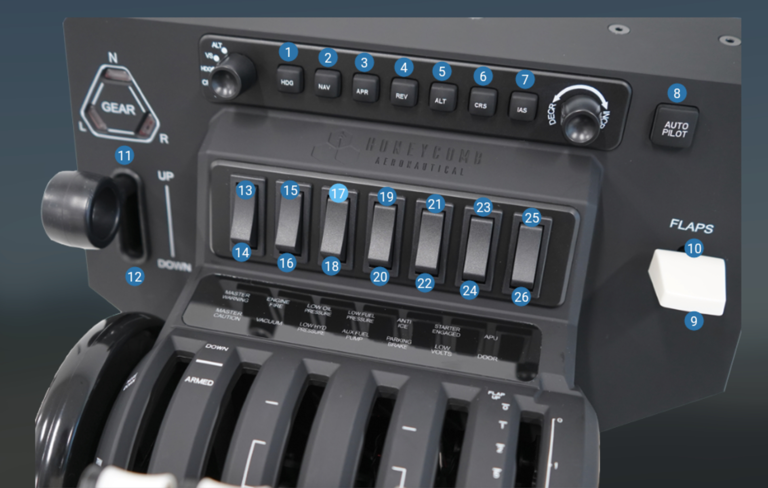
HoneycombOnArm64MacOS
Plug-in Features
Assign commands for all rotary controls
Assign commands for all autopilot buttons
Assign datarefs for all annunciator lights
Assign datarefs for all autopilot button lights
Use Bravo switches to modify rotary and button behaviour
Built-in configs for all Laminar Research supplied aircraft
Uses JSON files to read/modify/create configs
© Dr Steve Proctor 2024
swp336@gmail.com
Configuration Guide vBeta1.01

Slide 3
Default Built-in Configurations
Ensure the plugin is installed and configured as shown in the Installation Guide
This document records the default configuration applied for each aircraft
known to the plugin.
The default configuration is written to the aircraft’s json file if the json file is
not present in the plug-in’s directory
See the user guide for information on modifying json files
HoneycombOnArm64MacOS
© Dr Steve Proctor 2024
swp336@gmail.com
Configuration Guide vBeta1.01

Slide 4
How to use this configuration guide
This guide has two ‘contents’ pages. One for all Laminar Research Aircraft and another for all 3rd party aircraft* known to the plugin.
In each contents page, clicking on an aircraft’s name will jump to the first information page for that aircraft.
Each information page has a link to jump back to the contents page. This make it easy to find the
right information without endlessly scrolling through the document.
Each aircraft has two pages of information
Page 1 is a table showing all the controls known to the plug-in for this aircraft and how they map onto
the buttons, rotary controls and switches
Page 2 is user guidance on how to select the various controls for this aircraft
HoneycombOnArm64MacOS
*The 3rd party list will grow over time as more aircraft are modelled.
© Dr Steve Proctor 2024
swp336@gmail.com
Configuration Guide vBeta1.01

Slide 5
Contents – Laminar Research Aircraft*
HoneycombOnArm64MacOS
Laminar Research Airliners
Airbus A330-300 | Boeing 737-800 | McDonnell Douglas MD-82
Laminar Research General Aviation
Beechcraft Baron 58 | Beechcraft King Air C90B | Cessna Citation X | Cessna Skyhawk / Floats | Cessna Skyhawk (G1000)
Cirrus SR-22 | Cirrus Vision SF50 | Lancair Evolution | Piper PA-18 Super Cub | Van’s RV-10
Laminar Research Helicopters
Robinson R22 Beta II / floats | Sikorsky S-76C
Laminar Research Military
Grumman F-14 Tomcat | McDonnell Douglas F-4 Phantom II | Stinson L5 Sentinel
Laminar Research Gliders |  | Ultralight | VTOL
Schleicher ASK 21 |  | Aero-Works Aerolite 103 | ALIA 250
*Click on an aircraft’s name to see its configuration guide
© Dr Steve Proctor 2024
swp336@gmail.com
Configuration Guide vBeta1.01

Slide 6
Contents – 3rd party aircraft*
HoneycombOnArm64MacOS
Airliners
Zibo 737-800X
*Click on an aircraft’s name to see its configuration guide
© Dr Steve Proctor 2024
swp336@gmail.com
Configuration Guide vBeta1.01

Slide 7
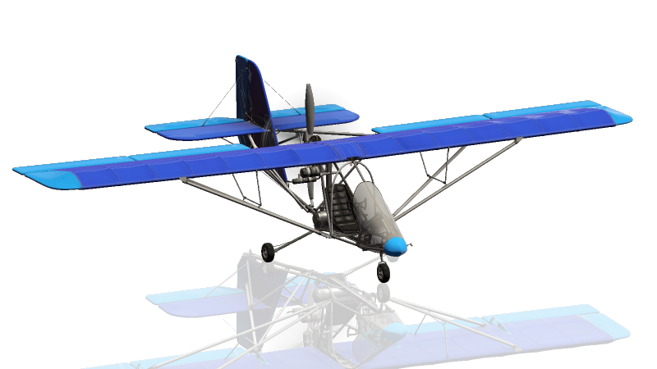
Laminar Aeroworks 103
HoneycombOnArm64MacOS
Default Configuration – Laminar Research Aeroworks 103
Rotary ALT | Rotary VS | Rotary HDG | Rotary CRS | Rotary IAS | Device | Active Toggle | Device | Button HDG | Button NAV | Button APR | Button REV | Button ALT | Button VS | Button IAS | Button AP
Barometer up/down | Barometer up/down | Barometer up/down | Barometer up/down | Barometer up/down | Instrument panel | None active |  | - | - | - | - | - | - | - | -
 |  |  |  |  |  | Toggle 7
 |  |  |  |  |  | Toggle 6
 |  |  |  |  |  | Toggle 5
 |  |  |  |  |  | Toggle 4
 |  |  |  |  |  | Toggle 3
 |  |  |  |  |  | Toggle 2
 |  |  |  |  |  | Toggle 1
for rotary controls, the lowest numbered active toggle is the one applied
for autopilot buttons, the highest numbered active toggle is the one applied
Back to contents
© Dr Steve Proctor 2024
swp336@gmail.com
Configuration Guide vBeta1.01

Slide 8
User guidance – Laminar Research Aeroworks 103
HoneycombOnArm64MacOS
The Aerowork 103 only has a single adjustable flight parameter, which is the Barometer pressure. The right-hand rotary always adjusts this parameter, independent of any settings on the left-hand rotary or the Toggle switches.
Back to contents
© Dr Steve Proctor 2024
swp336@gmail.com
Configuration Guide vBeta1.01

Slide 9
Laminar A330
HoneycombOnArm64MacOS
Default Configuration – Laminar Research Airbus A330-300
Rotary ALT | Rotary VS | Rotary HDG | Rotary CRS | Rotary IAS | Device | Active Toggle | Device | Button HDG | Button NAV | Button APR | Button REV | Button ALT | Button VS | Button IAS | Button AP
Altitude | Vertical speed | Heading | - | Airspeed | MCP | None active | MCP | HDG TRK V/S FPA | LOC | APPR | - | ALT | Vertical speed | A/THR | AP1
fast/slow |  | fast/slow |  | fast/slow | MCP | Toggle 7
Altitude 100 / 1000 flip |  |  |  |  | MCP | Toggle 6 | MCP |  |  |  |  | copilot baro std off
Pilot QNH |  |  |  |  | MCP | Toggle 5 | MCP |  |  |  |  | Copilot baro std on
Copilot QNH |  |  |  |  | MCP | Toggle 4 | MCP |  |  |  |  | Captain baro std off
Backup QNH |  |  |  |  | Centre panel | Toggle 3 | MCP |  |  |  |  | Captain baro std on |  | SPD MACH
 |  |  |  |  |  | Toggle 2 | MCP | Heading pull |  | Copilot LS |  | ALT knob pull |  | Speed pull
 |  |  |  |  |  | Toggle 1 | MCP | Heading push |  | Captain LS |  | ALT knob push |  | Speed push | AP2
for rotary controls, the lowest numbered active toggle is the one applied
for autopilot buttons, the highest numbered active toggle is the one applied
Back to contents
© Dr Steve Proctor 2024
swp336@gmail.com
Configuration Guide vBeta1.01

Slide 10
User guidance – Laminar Research Airbus A330-300
HoneycombOnArm64MacOS
Altitude – there are two ways to control the rotary speed when setting the MCP altitude.
Method 1 – Use the airbus built-in controls - The airbus provide a control to switch between altitude 100s and 1000s. Set the left-hand rotary to ALT and activate Toggle 6. This will enable you to switch between 100s and 1000s. Once the required units are selected (e.g., 1000s), deactivate Toggle 6 (make sure no other toggles active) and use the right-hand rotary to adjust the selected unit of the altitude. Then repeat to set the other unit (e.g., 100s).
Note, Toggle 7 (fast/slow) is still active here and you may want to activate it (slow mode) when
using method 1 to set the altitude.
Method 2 – use the plugin’s fast/slow feature ( Toggle 7) - set the airbus selector to 100s as described above.
Then use the right-hand rotary in conjunction with Toggle 7 (fast/slow) to control the rate of adjustment.
Back to contents
© Dr Steve Proctor 2024
swp336@gmail.com
Configuration Guide vBeta1.01

Slide 11
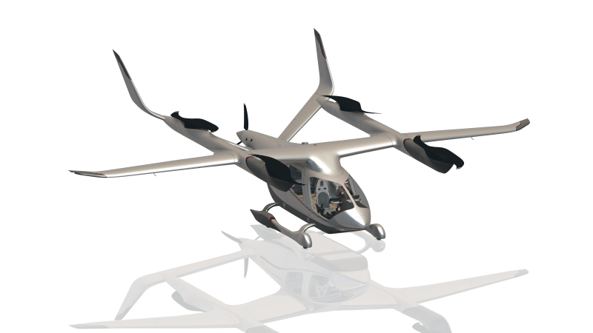
Laminar ALIA 250
Default Configuration – Laminar Research ALIA 250
HoneycombOnArm64MacOS
Rotary ALT | Rotary VS | Rotary HDG | Rotary CRS | Rotary IAS | Device | Active Toggle | Device | Button HDG | Button NAV | Button APR | Button REV | Button ALT | Button VS | Button IAS | Button AP
Altitude up/down | Vertical speed up/down | Heading up/down | LOC1 / LOC2 up/down | - | PFD | None active | PFD | HDG | NAV | APR | CDI | ALT | VS | - | AP
fast/slow |  | fast/slow | fast/slow | fast/slow |  | Toggle 7
Barometer up/down |  |  | NAV coarse up/down | NAV fine up/down | PFD | Toggle 6 | PFD | NAV 1-2 toggle | NAV flip active
 |  |  | COM coarse up/down | COM fine up/down |  | Toggle 5 |  | COM 1-2 toggle | COM flip active
 |  | FPL range up/down | FPL chapter up/down | FPL page up/down | MFD | Toggle 4 | MFD | PFD CDI | FPL | PROC | Direct | MENU | CLR | CURSOR | ENT
 |  |  |  |  |  | Toggle 3
 |  |  |  |  |  | Toggle 2
 |  |  |  |  |  | Toggle 1 |  | Heading sync | LOC1 / LOC2 sync
*
*
for rotary controls, the lowest numbered active toggle is the one applied
for autopilot buttons, the highest numbered active toggle is the one applied
* Aligned configuration – only one Toggle to be active at a time
Back to contents
© Dr Steve Proctor 2024
swp336@gmail.com
Configuration Guide vBeta1.01

Slide 12
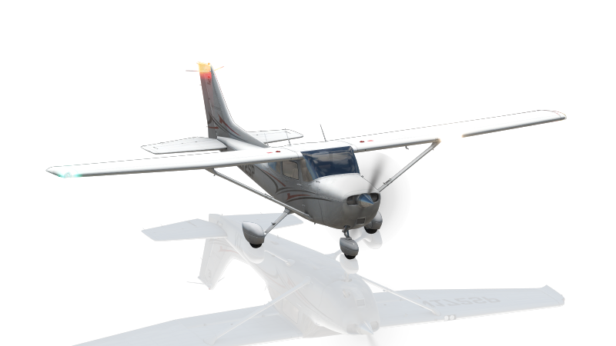
User guidance – Laminar Research ALIA 250
HoneycombOnArm64MacOS
PFD - Use Toggles 6* to configure the PFD NAV frequencies. Set Toggle 6 (check no other Toggles active) and move the left-hand rotary to its bottom position (IAS). Press the HDG button to flip between NAV1 & NAV2 as required. Use the right-hand rotary to adjust the frequency. Use the left-hand rotary in the bottom two positions (IAS & CRS) to flip between adjusting the frequency right and left of the decimal (equivalent to adjusting the inner and outer knobs on the NAV control). Once the correct frequency is set, press the NAV button to flip the NAVx active and standby values.
Similarly, Toggle 5* (check no other toggles active) adjusts the PFD COM frequencies.
MFD flight plan entry. Set Toggle 4* (check no other Toggles active) and move the left-hand rotary to its
bottom position (IAS). The autopilot button map to the MFD buttons. Press FLP, PROC, Direct or MENU as
required. Use the IAS button to select the first field and then use right-hand rotary to move between fields.
Press AP to ‘enter’ a value. Use the left-hand rotary in the bottom two positions (IAS & CRS) to flip between
scrolling through a list and moving between lists (equivalent to adjusting the inner and outer knobs on
the FMS control).
If you move the left-hand rotary to its middle position (HDG) then the right-hand rotary zooms in and out
of the map.
* Aligned configuration – only one Toggle to be active at a time
Back to contents
© Dr Steve Proctor 2024
swp336@gmail.com
Configuration Guide vBeta1.01

Slide 13

Laminar Beechcraft Baron 58
Default Configuration – Laminar Beechcraft Baron 58
HoneycombOnArm64MacOS
Rotary ALT | Rotary VS | Rotary HDG | Rotary CRS | Rotary IAS | Device | Active Toggle | Device | Button HDG | Button NAV | Button APR | Button REV | Button ALT | Button VS | Button IAS | Button AP
- | Vertical Speed up/down | Heading up/down | OBS HSI up/down | - | Instrument panel | None active | AP panel | HDG | NAV | APPR | BC | ALT | - | - | AP
 |  | fast/slow | fast/slow | fast/slow |  | Toggle 7
Barometer pilot up/down |  | ADF dial up/down | COM/VLOC coarse up/down | COM/VLOC fine up/down | G530 | Toggle 6 | G530 | COM–VLOC toggle | VLOC flip active | COM flip active
Barometer copilot up/down |  | Map range up/down | FPL chapter up/down | FPL page up/down |  | Toggle 5 |  | CDI | FLP | PROC | Direct | MENU | CLR | CURSOR | ENT
 |  |  | COM2 coarse up/down | COM2 fine up/down | Radio panel | Toggle 4 | Radio panel | COM2 flip active
 |  |  | NAV2 coarse up/down | NAV2 fine up/down |  | Toggle 3 |  | NAV2 flip active
 |  | ADF mode selector | ADF 100s up/down | ADF 10s up/down | ADF | Toggle 2 | ADF | ADF flip active
1s up/down | 10s up/down | 100s up/down | 1000s up/down | XPDR mode Selector | Transponder | Toggle 1
*
*
*
for rotary controls, the lowest numbered active toggle is the one applied
for autopilot buttons, the highest numbered active toggle is the one applied
* Aligned configuration – only one Toggle to be active at a time
Back to contents
© Dr Steve Proctor 2024
swp336@gmail.com
Configuration Guide vBeta1.01

Slide 14
User guidance – Laminar Beechcraft Baron 58
HoneycombOnArm64MacOS
G530 - Use Toggles 5 and 6 to configure the G530. Toggle 6* lets you adjust the COM and VLOC frequencies. Set Toggle 6 (check no other Toggles active) and move the left-hand rotary to its bottom position (IAS). Press the HDG button to flip between COM and VLOC as required. Use the right-hand rotary to adjust the frequency. Use the left-hand rotary in the bottom two positions (IAS & CRS) to flip between adjusting the frequency right and left of the decimal (equivalent to adjusting the inner and outer knobs on the COM/VLOC control). Once the correct frequency is set, press the NAV button to flip the VLOC active and standby values or the APR button to flip the COM active and standby.
Similarly, Toggle 5* (check no other toggles active) adjusts the right-hand G530 control, which is used
to input the flight plan and related data. The other autopilot buttons map the to FPL, VNAV, PROC, ENT,
CLR, MENU and Direct buttons plus PUSH/CRSR.
G430 – same as the G530, with Toggle 4* adjusting COM/VLOC and Toggle 3* adjusting the flight plan.
ADF – Toggle 2* (check no other toggle active) adjusts the ADF frequency. Use the HDG position to turn on/off the ADF as
required. Use IAS to set the 10s units (Toggle 7 available here to control the speed of adjustment and CRS to set the
1000s. One the correct frequency is dialed in, the HDG button will flip the active/standby values.
Transponder - Set Toggle 1* (check no other Toggles active) and move the left-hand rotary to its lower position (IAS)
Use the right-hand rotary to adjust the transponder mode the STBY
Move the left-hand rotary up one click (CRS) and set the 1000s digit for the transponder code
Repeat one click up and one digit set until all 4 digits are correct
Move the left-hand rotary back to its lower position (IAS) and set the transponder mode to ON or TST as required
* Aligned configuration – only one Toggle to be active at a time
Back to contents
© Dr Steve Proctor 2024
swp336@gmail.com
Configuration Guide vBeta1.01

Slide 15

Laminar Beechcraft King Air C90B
Default Configuration – Laminar Beechcraft King Air C90B
HoneycombOnArm64MacOS
Rotary ALT | Rotary VS | Rotary HDG | Rotary CRS | Rotary IAS | Device | Active Toggle | Device | Button HDG | Button NAV | Button APR | Button REV | Button ALT | Button VS | Button IAS | Button AP
Altitude up/down | Nose pitch up/down | Heading up/down | - | - | AP panel | None active | AP panel | Heading | NAV | Approach | Back course | Altitude hold | Vertical speed | Speed hold | Servos toggle
 |  | fast/slow | fast/slow | fast/slow |  | Toggle 7
Barometer pilot up/down |  | OBS HSI up/down | COM/VLOC coarse up/down | COM/VLOC fine up/down | G530 | Toggle 6 | G530 | COM-VLOC toggle | VLOC flip active | COM flip active
Barometer copilot up/down |  | HSI Select up/down | FPL chapter up/down | FPL page up/down |  | Toggle 5 |  | CDI | FPL | PROC | Direct | MENU | CLR | CURSOR | ENT
 |  |  | COM/VLOC coarse up/down | COM/VLOC fine up/down | G430 | Toggle 4 | G430 | COM-VLOC toggle | VLOC flip active | COM flip active
 |  |  | FPL chapter up/down | FPL page up/down |  | Toggle 3 |  | CDI | FPL | PROC | Direct | MENU | CLR | CURSOR | ENT
 |  | xpdr mode select | xpdr 100s up/down | xpdr 10s up/down | XPDR | Toggle 2 | XPDR | Transponder ident | CRS sync Select |  |  | altSel100 | descend
 |  |  |  |  |  | Toggle 1 | AP panel |  | CRS select |  |  | Altitude arm | climb
*
*
*
*
for rotary controls, the lowest numbered active toggle is the one applied
for autopilot buttons, the highest numbered active toggle is the one applied
* Aligned configuration – only one Toggle to be active at a time
Back to contents
© Dr Steve Proctor 2024
swp336@gmail.com
Configuration Guide vBeta1.01

Slide 16
User guidance – Laminar Beechcraft King Air C90B
HoneycombOnArm64MacOS
G530 - Use Toggles 5 and 6 to configure the G530. Toggle 6* lets you adjust the COM and VLOC frequencies. Set Toggle 6 (check no other Toggles active) and move the left-hand rotary to its bottom position (IAS). Press the HDG button to flip between COM and VLOC as required. Use the right-hand rotary to adjust the frequency. Use the left-hand rotary in the bottom two positions (IAS & CRS) to flip between adjusting the frequency right and left of the decimal (equivalent to adjusting the inner and outer knobs on the COM/VLOC control). Once the correct frequency is set, press the NAV button to flip the VLOC active and standby values or the APR button to flip the COM active and standby.
Similarly, Toggle 5* (check no other toggles active) adjusts the right-hand G530 control, which is used
to input the flight plan and related data. The other autopilot buttons map the to CDI, FPL, PROC, ENT,
CLR, MENU and Direct buttons plus PUSH/CRSR (i.e., select/cursor)
G430 – same as the G530, with Toggle 4* adjusting COM/VLOC and Toggle 3* adjusting the flight plan.
Transponder - Set Toggle 2* (check no other Toggles active) and move the left-hand rotary to its bottom
position (IAS). Set the first 2 digits of the transponder code. Move the left-hand rotary up one position (CRS).
Set the next 2 digits of the transponder code. Move the left-hand rotary up on position (HDG). Set the
transponder mode. The HDG button presses the Transponder Ident button.
* Aligned configuration – only one Toggle to be active at a time
Back to contents
© Dr Steve Proctor 2024
swp336@gmail.com
Configuration Guide vBeta1.01

Slide 17

Laminar Boeing 737
Default Configuration – Laminar Research Boeing 737
HoneycombOnArm64MacOS
Rotary ALT | Rotary VS | Rotary HDG | Rotary CRS | Rotary IAS | Active Toggle | Button HDG | Button NAV | Button APR | Button REV | Button ALT | Button VS | Button IAS | Button AP
Altitude up/down | Vertical speed up/down | Heading up/down | Pilot COURSE up/down | Airspeed up/down | None active | Heading select | LNAV | APP | - | ALT HOLD | VS | Speed | CMD A
fast/slow |  | fast/slow | fast/slow |  | Toggle 7
Captain Barometer up/down |  | MAP zoom in/out | Copilot COURSE up/down |  | Toggle 6
Copilot Barometer up/down |  | Bank angle up/down |  |  | Toggle 5
Captain decision height up/down |  | EFI mode up/down |  |  | Toggle 4 |  |  |  |  | Copilot EFIS RST
Copilot decision height up/down |  |  |  |  | Toggle 3 |  |  |  |  | Copilot EFIS STD |  |  | CWS B
Captain HPA / IN flip |  |  |  |  | Toggle 2 | Captain EFIS TFC |  |  |  | Captain EFIS RST |  |  | CWS A
Copilot HPA / IN flip |  |  |  |  | Toggle 1 | Captain EFIS CTR | VNAV | VOR/LOC |  | Captain EFIS STD | Level change |  | CMD B
for rotary controls, the lowest numbered active toggle is the one applied
for autopilot buttons, the highest numbered active toggle is the one applied
Back to contents
© Dr Steve Proctor 2024
swp336@gmail.com
Configuration Guide vBeta1.01

Slide 18
User guidance – Laminar Research Boeing 737
HoneycombOnArm64MacOS
The most common controls in flight operate by default (i.e., when no toggles are active).
Rotary workflows move with the toggles from right to left.
For example, for Altitude related functions set the left-hand rotary to the ALT position.
By default the right-hand rotary will adjust the altitude setting in the PFD (note that Toggle 7 can be used here to control moving quickly or accurately when adjusting the altitude).
Activating Toggle 6 will enable setting the captain PFD QNH,
Activating Toggle 5 will enable setting the copilot PFD QNH (no need to deactivate Toggle 6)
Activating Toggle 4 will enable setting the captain decision height (no need to deactivate Toggle 5)
Activating Toggle 3 will enable setting the copilot decision height (no need to deactivate Toggle 4, see note*)
Activating Toggle 2 will enable setting the captain Baro units (no need to deactivate Toggle 3, see note*)
Activating Toggle 1 will enable setting the copilot Baro units (no need to deactivate Toggle 2, see note*)
Now that the workflow is complete, unset all toggles.
The same approach applies to the other rotaries.
Button workflows move with the Toggles from left to right.
For example, for Heading related functions
By default the HDG button on the Bravo triggers the HDG button AP panel
Activating Toggle 1 maps the HDG button on the Bravo to the Captain’s EFIS CTR button
Activating Toggle 2 maps the HDG button on the Bravo to the Captain’s EFIS TFC button(note, no need to deactivate Toggle 1 but this will change other buttons)
Activating Toggle 3 maps the HDG button on the Bravo to the OBS Direct function on the PFD (no need to deactivate Toggle 2, but this will change other buttons).
* Note, for this aircraft the Buttons use Toggles 1-4 and the Rotarys use Toggles 1-7, so care must be taken when using Toggles 1-4. These toggles affect multiple
functions and could lead to unintended results if you set a toggle with one particular control in mind, then adjust another control without realising it has also been
re-mapped.
Back to contents
© Dr Steve Proctor 2024
swp336@gmail.com
Configuration Guide vBeta1.01

Slide 19
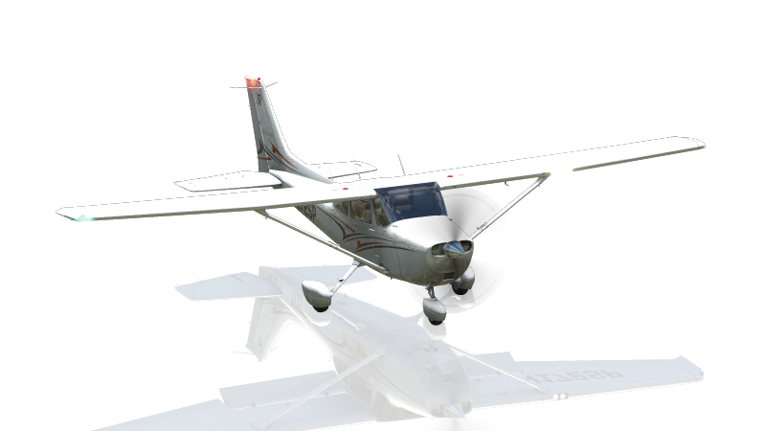
Laminar Cessna Skyhawk
Default Configuration – Laminar Research Cessna Skyhawk
HoneycombOnArm64MacOS
Rotary ALT | Rotary VS | Rotary HDG | Rotary CRS | Rotary IAS | Device | Active Toggle | Device | Button HDG | Button NAV | Button APR | Button REV | Button ALT | Button VS | Button IAS | Button AP
Barometer up/down | Vertical speed up/down | Heading up/down | OBS1 up/down | - |  | None active |  | Heading | NAV | Approach | Back course | Altitude hold | Vertical speed | - | Servos toggle
 |  | fast/slow | fast/slow | fast/slow |  | Toggle 7
 |  | OBS1 up/down | COM/VLOC coarse up/down | COM/VLOC fine up/down | G530 | Toggle 6 | G530 | COM-VLOC toggle | VLOC flip active | COM flip active
 |  | OBS2 up/down | FPL chapter up/down | FPL page up/down |  | Toggle 5 |  | CDI | FPL | PROC | Direct | MENU | CLR | CURSOR | ENT
 |  | ADF HDG up/down | COM/VLOC coarse up/down | COM/VLOC fine up/down | G430 | Toggle 4 | G430 | COM-VLOC toggle | VLOC flip active | COM flip active
 |  | Gyro sync up/down | FPL chapter up/down | FPL page up/down |  | Toggle 3 |  | CDI | FPL | PROC | Direct | MENU | CLR | CURSOR | ENT
 |  | ADF Freq 100s up/down |  |  | ADF | Toggle 2 | ADF |  |  |  |  |  |  | ADF flip active
 |  | ADF Freq 10s up/down |  |  |  | Toggle 1
*
*
*
*
for rotary controls, the lowest numbered active toggle is the one applied
for autopilot buttons, the highest numbered active toggle is the one applied
* Aligned configuration – only one Toggle to be active at a time
Back to contents
© Dr Steve Proctor 2024
swp336@gmail.com
Configuration Guide vBeta1.01

Slide 20
User guidance – Laminar Research Cessna Skyhawk
HoneycombOnArm64MacOS
G530 - Use Toggles 5 and 6 to configure the G530. Toggle 6* lets you adjust the COM and VLOC frequencies. Set Toggle 6 (check no other Toggles active) and move the left-hand rotary to its bottom position (IAS). Press the HDG button to flip between COM and VLOC as required. Use the right-hand rotary to adjust the frequency. Use the left-hand rotary in the bottom two positions (IAS & CRS) to flip between adjusting the frequency right and left of the decimal (equivalent to adjusting the inner and outer knobs on the COM/VLOC control). Once the correct frequency is set, press the NAV button to flip the VLOC active and standby values or the APR button to flip the COM active and standby.
Similarly, Toggle 5* (check no other toggles active) adjusts the right-hand G530 control, which is used
to input the flight plan and related data. The other autopilot buttons map the to CDI, FPL, PROC, ENT,
CLR, MENU and Direct buttons plus PUSH/CRSR (.e., select/cursor).
G430 – same as the G530, with Toggle 4* adjusting COM/VLOC and Toggle 3 adjusting the flight plan.
ADF Frequency - Set Toggle 1* (check no other Toggles active) and move the left-hand rotary to position HDG.
Set the first 2 digits of the ADF frequency code. Set Toggle 2 (unset Toggle 1), set the next 2 digits of the
ADF frequency. The IAS button flips the active/standby frequency.
* Aligned configuration – only one Toggle to be active at a time
Back to contents
© Dr Steve Proctor 2024
swp336@gmail.com
Configuration Guide vBeta1.01

Slide 21
Laminar Cessna Skyhawk G1000
Default Configuration – Laminar Cessna Skyhawk G1000
HoneycombOnArm64MacOS
Rotary ALT | Rotary VS | Rotary HDG | Rotary CRS | Rotary IAS | Device | Active Toggle | Device | Button HDG | Button NAV | Button APR | Button REV | Button ALT | Button VS | Button IAS | Button AP
Altitude 1000s up/down | Vertical Speed up/down | Heading up/down | VOR1 / LOC2 up/down | - | PFD | None active | PFD | HDG | NAV | APR | BC | ALT | VS | FLC | AP
fast/slow |  | fast/slow | fast/slow | fast/slow |  | Toggle 7
Altitude 100s up/down |  |  | NAV coarse up/down | NAV fine up/down | PFD | Toggle 6 | PFD | NAV 1-2 toggle | NAV flip active
Barometer up/down |  |  | COM coarse up/down | COM fine up/down |  | Toggle 5 |  | COM 1-2 toggle | COM flip active
 |  | FLP range up/down | FPL chapter up/down | FPL page up/down | MFD | Toggle 4 | MFD | CDI | FPL | PROC | Direct | MENU | CLR | CURSOR | ENT
 |  |  |  |  |  | Toggle 3
 |  |  |  |  |  | Toggle 2
 |  |  |  |  |  | Toggle 1 | PFD | Heading sync
*
*
for rotary controls, the lowest numbered active toggle is the one applied
for autopilot buttons, the highest numbered active toggle is the one applied
* Aligned configuration – only one Toggle to be active at a time
Back to contents
© Dr Steve Proctor 2024
swp336@gmail.com
Configuration Guide vBeta1.01

Slide 22
User guidance – Laminar Cessna Skyhawk G1000
HoneycombOnArm64MacOS
PFD - Use Toggles 6 to configure the PFD NAV frequencies. Set Toggle 6* (check no other Toggles active) and move the left-hand rotary to its bottom position (IAS). Press the HDG button to flip between NAV1 & NAV2 as required. Use the right-hand rotary to adjust the frequency. Use the left-hand rotary in the bottom two positions (IAS & CRS) to flip between adjusting the frequency right and left of the decimal (equivalent to adjusting the inner and outer knobs on the NAV control). Once the correct frequency is set, press the NAV button to flip the NAVx active and standby values.
Similarly, Toggle 5* (check no other toggles active) adjusts the PFD COM frequencies.
MFD flight plan entry. Set Toggle 4* (check no other Toggles active) and move the left-hand rotary to its
bottom position (IAS). The autopilot button map to the MFD buttons. Press CDI, FLP, PROC, Direct or MENU as
required. Use the IAS button to select the first field and then use right-hand rotary to move between fields.
Press AP to ‘enter’ a value. Use the left-hand rotary in the bottom two positions (IAS & CRS) to flip between
scrolling through a list and moving between lists (equivalent to adjusting the inner and outer knobs on
the FMS control).
If you move the left-hand rotary to its middle position (HDG) then the right-hand rotary zooms in and out
of the map.
* Aligned configuration – only one Toggle to be active at a time
Back to contents
© Dr Steve Proctor 2024
swp336@gmail.com
Configuration Guide vBeta1.01

Slide 23
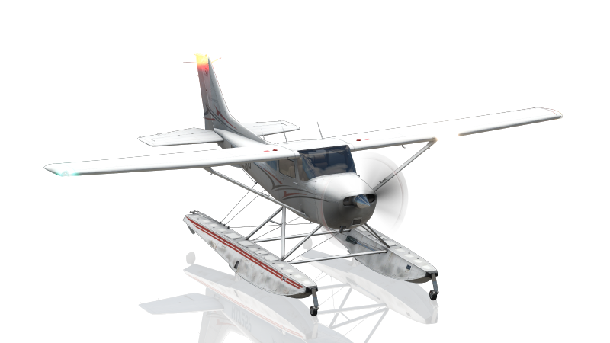
Laminar Cessna Skyhawk Floats
Default Configuration – Laminar Cessna Skyhawk Floats
HoneycombOnArm64MacOS
Rotary ALT | Rotary VS | Rotary HDG | Rotary CRS | Rotary IAS | Device | Active Toggle | Device | Button HDG | Button NAV | Button APR | Button REV | Button ALT | Button VS | Button IAS | Button AP
Barometer up/down | Vertical speed up/down | Heading up/down | OBS1 up/down | - |  | None active |  | Heading | NAV | Approach | Back course | Altitude hold | Vertical speed | - | Servos toggle
 |  | fast/slow | fast/slow | fast/slow |  | Toggle 7
 |  | OBS1 up/down | COM/VLOC coarse up/down | COM/VLOC fine up/down | G530 | Toggle 6 | G530 | COM-VLOC toggle | VLOC flip active | COM flip active
 |  | OBS2 up/down | FPL chapter up/down | FPL page up/down |  | Toggle 5 |  | CDI | FPL | PROC | Direct | MENU | CLR | CURSOR | ENT
 |  | ADF HDG up/down | COM/VLOC coarse up/down | COM/VLOC fine up/down | G430 | Toggle 4 | G430 | COM-VLOC toggle | VLOC flip active | COM flip active
 |  | Gyro sync up/down | FPL chapter up/down | FPL page up/down |  | Toggle 3 |  | CDI | FPL | PROC | Direct | MENU | CLR | CURSOR | ENT
 |  | ADF Freq 100s up/down |  |  | ADF | Toggle 2 | ADF |  |  |  |  |  |  | ADF flip active
 |  | ADF Freq 10s up/down |  |  |  | Toggle 1
*
*
*
*
for rotary controls, the lowest numbered active toggle is the one applied
for autopilot buttons, the highest numbered active toggle is the one applied
* Aligned configuration – only one Toggle to be active at a time
Back to contents
© Dr Steve Proctor 2024
swp336@gmail.com
Configuration Guide vBeta1.01

Slide 24
User guidance – Laminar Cessna Skyhawk Floats
HoneycombOnArm64MacOS
G530 - Use Toggles 5 and 6 to configure the G530. Toggle 6 lets you adjust the COM and VLOC frequencies. Set Toggle 6* (check no other Toggles active) and move the left-hand rotary to its bottom position (IAS). Press the HDG button to flip between COM and VLOC as required. Use the right-hand rotary to adjust the frequency. Use the left-hand rotary in the bottom two positions (IAS & CRS) to flip between adjusting the frequency right and left of the decimal (equivalent to adjusting the inner and outer knobs on the COM/VLOC control). Once the correct frequency is set, press the NAV button to flip the VLOC active and standby values or the APR button to flip the COM active and standby.
Similarly, Toggle 5* (check no other toggles active) adjusts the right-hand G530 control, which is used
to input the flight plan and related data. The other autopilot buttons map the to CDI, FPL, PROC, ENT,
CLR, MENU and Direct buttons plus PUSH/CRSR.
G430 – same as the G530, with Toggle 4* adjusting COM/VLOC and Toggle 3* adjusting the flight plan.
ADF Frequency - Set Toggle 1* (check no other Toggles active) and move the left-hand rotary to position HDG.
Set the first 2 digits of the ADF frequency code. Set Toggle 2 (unset Toggle 1), set the next 2 digits of the
ADF frequency. The IAS button flips the active/standby frequency.
* Aligned configuration – only one Toggle to be active at a time
Back to contents
© Dr Steve Proctor 2024
swp336@gmail.com
Configuration Guide vBeta1.01

Slide 25

Laminar Cessna Citation X
Default Configuration – Laminar Research Cessna Citation X
HoneycombOnArm64MacOS
Rotary ALT | Rotary VS | Rotary HDG | Rotary CRS | Rotary IAS | Device | Active Toggle | Device | Button HDG | Button NAV | Button APR | Button REV | Button ALT | Button VS | Button IAS | Button AP
Altitude up/down | NOSE UP / NOSE DN | Pilot heading up/down | Pilot OBS up/down | - | PFD | None active | Honeywell AP | HDG | NAV | APP | BC | ALT | VS | FLC | AP
slow/fast |  | slow/fast | slow/fast |  | - | Toggle 7
Captain barometer up/down |  | Copilot heading up/down | Copilot OBS up/down |  | PFD | Toggle 6
Standby barometer up/down |  |  |  |  | BACKUP ALTIMETER | Toggle 5
Minimums up/down |  |  |  |  | PFD | Toggle 4
 |  |  |  |  |  | Toggle 3 | PFD | OBS HSI direct |  |  |  |  |  |  | YD
 |  |  |  |  |  | Toggle 2 | Honeywell AP | PFD HDG sync |  |  |  | RA / BARO |  |  | PFD SEL
 |  |  |  |  |  | Toggle 1 | Honeywell AP | BANK | VNAV |  |  | PFD STD | M TRIM | C\O | STBY
for rotary controls, the lowest numbered active toggle is the one applied
for autopilot buttons, the highest numbered active toggle is the one applied
Back to contents
© Dr Steve Proctor 2024
swp336@gmail.com
Configuration Guide vBeta1.01

Slide 26
User guidance – Laminar Research Cessna Citation X
HoneycombOnArm64MacOS
The most common controls in flight operate by default (i.e., when no toggles are active).
Rotary workflows move with the toggles from right to left.
For example, for Altitude related functions set the left-hand rotary to the ALT position.
By default the right-hand rotary will adjust the altitude setting in the PFD (note that Toggle 7 can be used here to control moving quickly or accurately when adjusting the altitude).
Activating Toggle 6 will enable setting the PFD QNH,
Activating Toggle 5 will enable setting the backup altimeter QNH (note, no need to deactivate Toggle 6 as there are no aligned configurations for this aircraft).
Activating Toggle 4 will enable setting the PFD minimums (no need to deactivate Toggle 5)
Now that the workflow is complete, unset all toggles.
The same approach applies to the other rotaries.
Button workflows move with the Toggles from left to right.
For example, for Heading related functions
By default the HDG button on the Bravo triggers the HDG button on the Citation Honeywell AP panel
Activating Toggle 1 maps the HDG button on the Bravo to the BANK button on the AP panel
Activating Toggle 2 maps the HDG button on the Bravo to the HDG sync function on the PFD (note, no need to deactivate Toggle 1 as there are no aligned
configurations for this aircraft).
Activating Toggle 3 maps the HDG button on the Bravo to the OBS Direct function on the PFD (no need to deactivate Toggle 2).
Note, for this aircraft the Buttons only use Toggle 1-3 and the Rotarys only use Toggles 4-7, so both Button settings and Rotary settings can be active
simultaneously as they do not overlap and will not interfere with each other. For example, Toggles 1 and 6 can both be active and you will get the
expected behaviour from the Buttons and Rotarys.
Back to contents
© Dr Steve Proctor 2024
swp336@gmail.com
Configuration Guide vBeta1.01

Slide 27
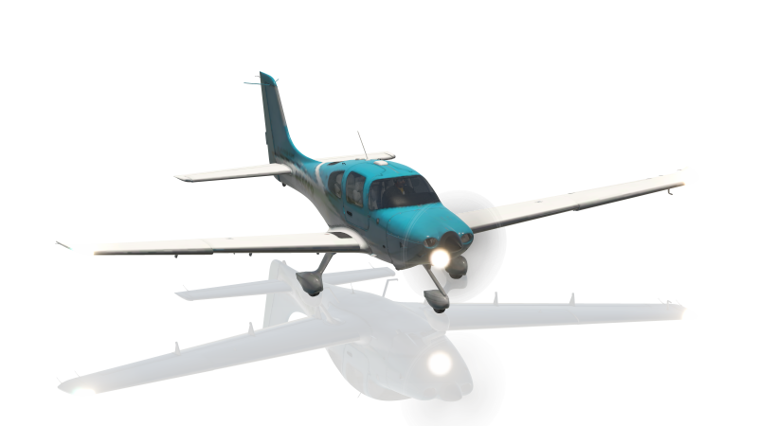
Laminar Cirrus SR22
Default Configuration – Laminar Research Cirrus SR22
HoneycombOnArm64MacOS
Rotary ALT | Rotary VS | Rotary HDG | Rotary CRS | Rotary IAS | Device | Active Toggle | Device | Button HDG | Button NAV | Button APR | Button REV | Button ALT | Button VS | Button IAS | Button AP
Altitude 1000s up/down | Vertical Speed up/down | Heading up/down | VOR1 / LOC2 up/down | - | PFD | None active | PFD | HDG | NAV | APR | - | ALT | VS | - | AP
fast/slow |  | fast/slow | fast/slow | fast/slow |  | Toggle 7
Altitude 100s up/down |  |  | NAV coarse up/down | NAV fine up/down | PFD | Toggle 6 | PFD | COM 1-2 toggle | COM flip active
Barometer up/down |  |  | COM coarse up/down | COM fine up/down |  | Toggle 5 | MFD | NAV 1-2 toggle | NAV flip active
 |  | FLP range up/down | FPL chapter up/down | FPL page up/down | MFD | Toggle 4 | AP Panel | - | FPL | PROC | Direct | MENU | CLR | CURSOR | ENT
 |  |  |  |  |  | Toggle 3
 |  |  |  |  |  | Toggle 2
 |  |  |  |  |  | Toggle 1 | AP panel | PFD Heading sync | VNV |  |  | LVL | FLC
*
*
for rotary controls, the lowest numbered active toggle is the one applied
for autopilot buttons, the highest numbered active toggle is the one applied
* Aligned configuration – only one Toggle to be active at a time
Back to contents
© Dr Steve Proctor 2024
swp336@gmail.com
Configuration Guide vBeta1.01

Slide 28
User guidance – Laminar Research Cirrus SR22
HoneycombOnArm64MacOS
PFD - Use Toggles 6 to configure the PFD COM frequencies. Set Toggle 6* (check no other Toggles active) and move the left-hand rotary to its bottom position (IAS). Press the HDG button to flip between COM1 & COM2 as required. Use the right-hand rotary to adjust the frequency. Use the left-hand rotary in the bottom two positions (IAS & CRS) to flip between adjusting the frequency right and left of the decimal (equivalent to adjusting the inner and outer knobs on the COM control). Once the correct frequency is set, press the NAV button to flip the COMx active and standby values.
Similarly, Toggle 5* (check no other toggles active) adjusts the MFD NAV frequencies.
MFD flight plan entry. Set Toggle 4* (check no other Toggles active) and move the left-hand rotary to its
bottom position (IAS). The autopilot button map to the MFD buttons. Press FLP, PROC, Direct or MENU as
required. Use the IAS button to select the first field and then use right-hand rotary to move between fields.
Press AP to ‘enter’ a value. Use the left-hand rotary in the bottom two positions (IAS & CRS) to flip between
scrolling through a list and moving between lists (equivalent to adjusting the inner and outer knobs on
the FMS control).
If you move the left-hand rotary to its middle position (HDG) then the right-hand rotary zooms in and out
of the map.
* Aligned configuration – only one Toggle to be active at a time
Back to contents
© Dr Steve Proctor 2024
swp336@gmail.com
Configuration Guide vBeta1.01

Slide 29

Laminar Cirrus Vision SF50
Default Configuration – Laminar Research Cirrus Vision SF50
HoneycombOnArm64MacOS
Rotary ALT | Rotary VS | Rotary HDG | Rotary CRS | Rotary IAS | Device | Active Toggle | Device | Button HDG | Button NAV | Button APR | Button REV | Button ALT | Button VS | Button IAS | Button AP
Altitude up/down | Nose up/down | Heading up/down | VOR1 / VOR2 up/down | - | PFD | None active | PFD | HDG | NAV | APR | - | ALT | VS | - | AP
fast/slow |  | fast/slow | fast/slow | fast/slow |  | Toggle 7
Barometer up/down |  |  | NAV coarse up/down | NAV fine up/down | PFD | Toggle 6 | PFD | NAV 1-2 toggle | NAV flip active
 |  |  | COM coarse up/down | COM fine up/down |  | Toggle 5 | PFD | COM 1-2 toggle | COM flip active
 |  | FLP range up/down | FPL chapter up/down | FPL page up/down | MFD | Toggle 4 | AP Panel | - | FPL | PROC | Direct | MENU | CLR | CURSOR | ENT
 |  |  |  |  |  | Toggle 3
 |  |  |  |  |  | Toggle 2 | AP panel | PFD CRS sync |  |  |  |  | LVL
 |  |  |  |  |  | Toggle 1 | AP panel | PFD Heading sync | VNV |  |  | Altitude sync | FLC
*
*
for rotary controls, the lowest numbered active toggle is the one applied
for autopilot buttons, the highest numbered active toggle is the one applied
* Aligned configuration – only one Toggle to be active at a time
Back to contents
© Dr Steve Proctor 2024
swp336@gmail.com
Configuration Guide vBeta1.01

Slide 30
User guidance – Laminar Research Cirrus Vision SF50
HoneycombOnArm64MacOS
PFD - Use Toggles 6 to configure the PFD NAV frequencies. Set Toggle 6* (check no other Toggles active) and move the left-hand rotary to its bottom position (IAS). Press the HDG button to flip between NAV1 & NAV2 as required. Use the right-hand rotary to adjust the frequency. Use the left-hand rotary in the bottom two positions (IAS & CRS) to flip between adjusting the frequency right and left of the decimal (equivalent to adjusting the inner and outer knobs on the NAV control). Once the correct frequency is set, press the NAV button to flip the NAVx active and standby values.
Similarly, Toggle 5* (check no other toggles active) adjusts the PFD COM frequencies.
MFD flight plan entry. Set Toggle 4* (check no other Toggles active) and move the left-hand rotary to its
bottom position (IAS). The autopilot button map to the MFD buttons. Press FLP, PROC, Direct or MENU as
required. Use the IAS button to select the first field and then use right-hand rotary to move between fields.
Press AP to ‘enter’ a value. Use the left-hand rotary in the bottom two positions (IAS & CRS) to flip between
scrolling through a list and moving between lists (equivalent to adjusting the inner and outer knobs on
the FMS control).
If you move the left-hand rotary to its middle position (HDG) then the right-hand rotary zooms in and out
of the map.
* Aligned configuration – only one Toggle to be active at a time
Back to contents
© Dr Steve Proctor 2024
swp336@gmail.com
Configuration Guide vBeta1.01

Slide 31
Laminar Grumman F14 Tomcat
Default Configuration – Laminar Grumman F14 Tomcat
HoneycombOnArm64MacOS
Rotary ALT | Rotary VS | Rotary HDG | Rotary CRS | Rotary IAS | Device | Active Toggle | Device | Button HDG | Button NAV | Button APR | Button REV | Button ALT | Button VS | Button IAS | Button AP
Barometer up/down | - | Heading up/down | VOR1 up/down | - | - | None active |  | Heading hold | - | - | - | Altitude hold | - | - | AP on
fast/slow |  | fast/slow | fast/slow |  |  | Toggle 7
Radar ALT up/down |  | VEC / ACL up/down | TCN mode up/down |  |  | Toggle 6 |  |  |  |  |  | Radar ALT test
 |  |  | TAC channel 1s up/down |  |  | Toggle 5
 |  |  | TAC channel 10s up/down |  |  | Toggle 4
 |  |  |  |  |  | Toggle 3
 |  |  |  |  |  | Toggle 2
 |  |  |  |  |  | Toggle 1 |  |  |  |  |  | Pitch sync |  |  | AP disconnect
*
for rotary controls, the lowest numbered active toggle is the one applied
for autopilot buttons, the highest numbered active toggle is the one applied
* Aligned configuration – only one Toggle to be active at a time
Back to contents
© Dr Steve Proctor 2024
swp336@gmail.com
Configuration Guide vBeta1.01

Slide 32
User guidance – Laminar Research Grumman F14 Tomcat
HoneycombOnArm64MacOS
Note: the VEC/ACL rotary and the Radar ALT test button both activate the relevant commands in the SIM, but in both cases this does not trigger the corresponding animation in the aircraft (button moving for VEC/ACL, test light illuminating for Radar ALT test.
Back to contents
© Dr Steve Proctor 2024
swp336@gmail.com
Configuration Guide vBeta1.01

Slide 33
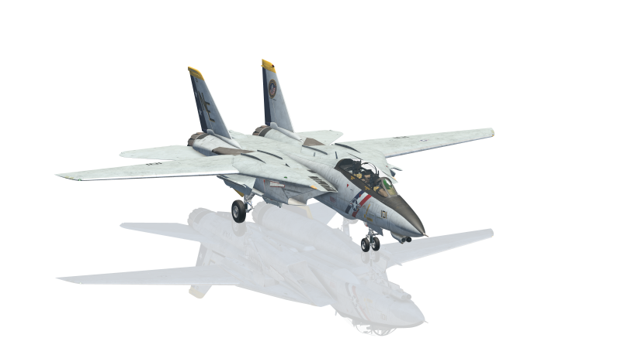
Laminar McDonnell Douglas F4 Phantom II
Default Configuration – Laminar Research MD F4 Phantom II
HoneycombOnArm64MacOS
Rotary ALT | Rotary VS | Rotary HDG | Rotary CRS | Rotary IAS | Device | Active Toggle | Device | Button HDG | Button NAV | Button APR | Button REV | Button ALT | Button VS | Button IAS | Button AP
- | - | Heading up/down | VOR1 up/down | - | Central panel | None active
 |  | fast/slow | fast/slow |  |  | Toggle 7
 |  |  | NAV 10s coarse up/down | NAV 100s fine up/down | Left-hand panel | Toggle 6
 |  |  | COM1 10s coarse up/down | COM1 100s fine up/down | Right-hand panel | Toggle 5
 |  |  | COM2 10s coarse up/down | COM2 100s fine up/down |  | Toggle 4
 |  |  |  |  |  | Toggle 3
 |  |  |  |  |  | Toggle 2
 |  |  |  |  |  | Toggle 1
*
*
for rotary controls, the lowest numbered active toggle is the one applied
for autopilot buttons, the highest numbered active toggle is the one applied
* Aligned configuration – only one Toggle to be active at a time
Back to contents
© Dr Steve Proctor 2024
swp336@gmail.com
Configuration Guide vBeta1.01

Slide 34
User guidance – Laminar Research MD F4 Phantom II
HoneycombOnArm64MacOS
NAV - Use Toggles 6 to configure the NAV frequency. Set Toggle 6* (check no other Toggles active) and move the left-hand rotary to its bottom position (IAS). Use the right-hand rotary to adjust the frequency. Use the left-hand rotary in the bottom two positions (IAS & CRS) to flip between adjusting the 100s and10s components of the frequency (equivalent to adjusting the left and right knobs on the NAV control).
Similarly, Toggle 5* (check no other toggles active) adjusts the COM1 frequency and Toggle 4*
(check no other toggles active) adjusts the COM2 frequency.
* Aligned configuration – only one Toggle to be active at a time
Back to contents
© Dr Steve Proctor 2024
swp336@gmail.com
Configuration Guide vBeta1.01

Slide 35
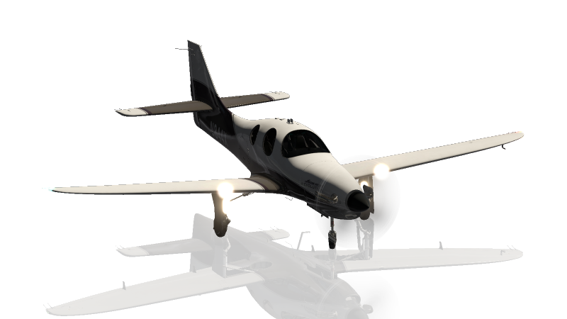
Laminar Lancair Evolution
Default Configuration – Laminar Research Lancair Evolution
HoneycombOnArm64MacOS
Rotary ALT | Rotary VS | Rotary HDG | Rotary CRS | Rotary IAS | Device | Active Toggle | Device | Button HDG | Button NAV | Button APR | Button REV | Button ALT | Button VS | Button IAS | Button AP
Altitude up/down | Nose up/down | Heading up/down | VOR1 / VOR2 up/down | - | PFD | None active | AP panel | TRK | NAV | APR | - | ALT | SEL | - | AP
fast/slow |  | fast/slow | fast/slow | fast/slow |  | Toggle 7
Barometer up/down |  |  | NAV coarse up/down | NAV fine up/down | PFD | Toggle 6 | PFD | NAV 1-2 toggle | NAV flip active
 |  |  | COM coarse up/down | COM fine up/down |  | Toggle 5 |  | COM 1-2 toggle | COM flip active
 |  | FLP range up/down | FPL chapter up/down | FPL page up/down | MFD | Toggle 4 | MFD | - | FPL | PROC | Direct | MENU | CLR | CURSOR | ENT
 |  |  |  |  |  | Toggle 3 | PFD
 |  |  |  |  |  | Toggle 2 |  | VOR sync | AP VNAV
 |  |  |  |  |  | Toggle 1 |  | Heading sync | AP GPSS |  |  | Altitude sync
*
*
for rotary controls, the lowest numbered active toggle is the one applied
for autopilot buttons, the highest numbered active toggle is the one applied
* Aligned configuration – only one Toggle to be active at a time
Back to contents
© Dr Steve Proctor 2024
swp336@gmail.com
Configuration Guide vBeta1.01

Slide 36
User guidance – Laminar Research Lancair Evolution
HoneycombOnArm64MacOS
PFD - Use Toggles 6 to configure the PFD NAV frequencies. Set Toggle 6* (check no other Toggles active) and move the left-hand rotary to its bottom position (IAS). Press the HDG button to flip between NAV1 & NAV2 as required. Use the right-hand rotary to adjust the frequency. Use the left-hand rotary in the bottom two positions (IAS & CRS) to flip between adjusting the frequency right and left of the decimal (equivalent to adjusting the inner and outer knobs on the NAV control). Once the correct frequency is set, press the NAV button to flip the NAVx active and standby values.
Similarly, Toggle 5* (check no other toggles active) adjusts the PFD COM frequencies.
MFD flight plan entry. Set Toggle 4* (check no other Toggles active) and move the left-hand rotary to its
bottom position (IAS). The autopilot button map to the MFD buttons. Press FLP, PROC, Direct or MENU as
required. Use the IAS button to select the first field and then use right-hand rotary to move between fields.
Press AP to ‘enter’ a value. Use the left-hand rotary in the bottom two positions (IAS & CRS) to flip between
scrolling through a list and moving between lists (equivalent to adjusting the inner and outer knobs on
the FMS control).
If you move the left-hand rotary to its middle position (HDG) then the right-hand rotary zooms in and out
of the map.
* Aligned configuration – only one Toggle to be active at a time
Back to contents
© Dr Steve Proctor 2024
swp336@gmail.com
Configuration Guide vBeta1.01

Slide 37

Laminar McDonnell Douglas 82
Default Configuration – Laminar McDonnell Douglas 82
HoneycombOnArm64MacOS
Rotary ALT | Rotary VS | Rotary HDG | Rotary CRS | Rotary IAS | Device | Active Toggle | Device | Button HDG | Button NAV | Button APR | Button REV | Button ALT | Button VS | Button IAS | Button AP
Altitude up/down | Nose up/down | Heading up/down | Pilot CRS up/down | Air speed up/down | MCP | None active | MCP | VOR LOC | FMS | ILS | - | Altitude hold | Vertical speed | Auto-throttle activate | AP
fast/slow |  | fast/slow | fast/slow | fast/slow |  | Toggle 7
 |  | Autopilot source 1-2 | Copilot CRS up/down |  | MCP | Toggle 6
 |  |  | NAV1 coarse up/down | NAV1 fine up/down | MCP | Toggle 5
 |  |  | NAV2 coarse up/down | NAV2 fine up/down |  | Toggle 4
 |  |  | COM1 left coarse up/down | COM1 left fine up/down | Radio panel | Toggle 3 | Radio panel |  | COM1 flip active
 |  |  | COM1 right coarse up/down | COM1 right fine up/down |  | Toggle 2 |  |  |  |  |  |  |  | IAS/Mach toggle
 |  |  |  |  |  | Toggle 1 | MCP | Heading dial pull | VNAV | Autoland |  |  |  | FMS OVRD
*
*
*
for rotary controls, the lowest numbered active toggle is the one applied
for autopilot buttons, the highest numbered active toggle is the one applied
* Aligned configuration – only one Toggle to be active at a time
Back to contents
© Dr Steve Proctor 2024
swp336@gmail.com
Configuration Guide vBeta1.01

Slide 38
User guidance – Laminar McDonnell Douglas 82
HoneycombOnArm64MacOS
MCP - Use Toggles 6 & 5 to configure the MCP NAV frequencies. Set Toggle 6* (check no other Toggles active) and move the left-hand rotary to its bottom position (IAS). Use the right-hand rotary to adjust the NAV1 frequency (use Toggle 5 for NAV2). Use the left-hand rotary in the bottom two positions (IAS & CRS) to flip between adjusting the frequency right and left of the decimal (equivalent to adjusting the inner and outer knobs on the NAV control).
Radio panel - Similarly, Toggles 4* & 3* (check no other toggles active) adjust the radio panel left and
right COM1 frequencies. (You can use Toggle 7 to control the speed it skips through the the decimal
values). Use the NAV button to flip the ‘active’ frequency switch between left and right.
* Aligned configuration – only one Toggle to be active at a time
Back to contents
© Dr Steve Proctor 2024
swp336@gmail.com
Configuration Guide vBeta1.01

Slide 39
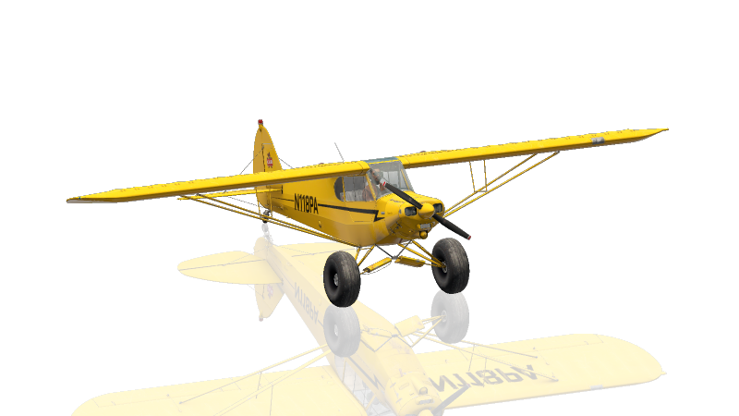
Laminar Piper PA-18 Super Cub
Default Configuration – Laminar Piper PA-18 Super Cub
HoneycombOnArm64MacOS
Rotary ALT | Rotary VS | Rotary HDG | Rotary CRS | Rotary IAS | Device | Active Toggle | Device | Button HDG | Button NAV | Button APR | Button REV | Button ALT | Button VS | Button IAS | Button AP
Barometer up/down | Artificial Horizon up/down | Gyro sync up/down | OBS up/down | - | Instrument cluster | None active |  |  |  |  |  |  |  |  | Engine starter
 |  |  | fast/slow | fast/slow |  | Toggle 7
Fuel selector up/down |  | COMM on/off | COMM coarse up/down | COMM fine up/down | COMM panel | Toggle 6 |  |  |  |  |  |  |  |  | COM1 active flip
Magnetos selector up/down |  | NAV on/off | NAV coarse up/down | NAV fine up/down | NAV panel | Toggle 5 |  |  |  |  |  |  |  |  | NAV1 active flip
XPDR 1s up/down | XPDR 10s up/down | XPDR 100s up/down | XPDR 1000s up/down | XPDR mode up/down | Transponder | Toggle 4
 |  |  |  |  |  | Toggle 3
 |  |  |  |  |  | Toggle 2
 |  |  |  |  |  | Toggle 1
*
for rotary controls, the lowest numbered active toggle is the one applied
for autopilot buttons, the highest numbered active toggle is the one applied
* Aligned configuration – only one Toggle to be active at a time
Back to contents
© Dr Steve Proctor 2024
swp336@gmail.com
Configuration Guide vBeta1.01

Slide 40
User guidance – Laminar Piper PA-18 Super Cub
HoneycombOnArm64MacOS
COMM - Use Toggle 6 to configure the COMM frequency.
Set Toggle 6* (check no other Toggles active)
If the COMM control is off, move the left-hand rotary to the HDG position and use the right-hand rotary to turn it on.
Move the left-hand rotary to its bottom position (IAS) and use the right-hand rotary to adjust the frequency. Use the left-hand rotary in the bottom two positions (IAS & CRS) to flip between adjusting the frequency right and left of the decimal (equivalent to adjusting the inner and outer knobs on the COMM control). Remember, you can use Toggle 7 to control the speed it skips through
the decimal values
Once the correct frequency is set, press the IAS button to flip the COMM active and standby values.
NAV - Similarly, Toggle 5* (check no other toggles active) adjusts the NAV frequency.
Transponder – Use Toggle 4 to adjust the transponder
Set Toggle 4* (check no other Toggles active)
Move the left-hand rotary to its upper position (ALT)
Use the right-hand rotary to adjust the transponder mode the STBY
Move the left-hand rotary down one click (VS) and set the 1000s digit for the transponder code
Repeat one click down and one digit set until all 4 digits are correct
Move the left-hand rotary back to its upper position (ALT) and set the transponder mode to ON or TST as required
* Aligned configuration – only one Toggle to be active at a time
Back to contents
© Dr Steve Proctor 2024
swp336@gmail.com
Configuration Guide vBeta1.01

Slide 41
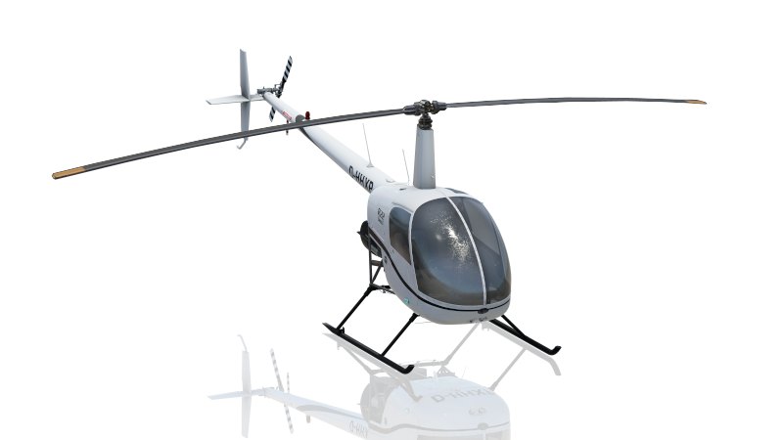
Laminar Robinson R22 Beta II
HoneycombOnArm64MacOS
Default Configuration – Laminar Robinson R22 Beta II (& floats)
Rotary ALT | Rotary VS | Rotary HDG | Rotary CRS | Rotary IAS | Device | Active Toggle | Device | Button HDG | Button NAV | Button APR | Button REV | Button ALT | Button VS | Button IAS | Button AP
Barometer up/down | - | - | VOR up/down | - | Main panel | None active | Main panel | - | - | - | - | BARO STD | - | - | -
 |  | fast/slow | fast/slow | fast/slow |  | Toggle 7
 |  |  | COM / NAV coarse up/down | COM / NAV fine up/down | G430 | Toggle 6 | G430 | NAV - COM toggle | NAV flip active | COM flip active
 |  | Map range up/down | FPL chapter up/down | FPL page up/down |  | Toggle 5 |  | CDI | FPL | PROC | Direct | MENU | CLR | CURSOR | ENT
 |  |  |  |  |  | Toggle 4
 |  |  |  |  |  | Toggle 3
 |  |  |  |  |  | Toggle 2
 |  |  |  |  |  | Toggle 1
*
for rotary controls, the lowest numbered active toggle is the one applied
for autopilot buttons, the highest numbered active toggle is the one applied
* Aligned configuration – only one Toggle to be active at a time
Back to contents
© Dr Steve Proctor 2024
swp336@gmail.com
Configuration Guide vBeta1.01

Slide 42
HoneycombOnArm64MacOS
User guidance – Laminar Research Robinson R22 Beta II (& floats)
G430 - Toggle 6* lets you adjust the COM and VLOC frequencies.
Set Toggle 6 (check no other Toggles active) and move the left-hand rotary to its bottom position (IAS).
Press the HDG button to flip between COM and VLOC as required. Use the right-hand rotary to adjust the frequency.
Use the left-hand rotary in the bottom two positions (IAS & CRS) to flip between adjusting the frequency right and left of the decimal (equivalent to adjusting the inner and outer knobs on the COM/VLOC control). Once the correct frequency is set, press the NAV button to flip the VLOC active and standby values or the APR button to flip the COM
active and standby.
Similarly, Toggle 5* (check no other toggles active) adjusts the right-hand G430 control, which is used
to input the flight plan and related data. The other autopilot buttons map the to CDI, FPL, VNAV, PROC, ENT,
CLR, MENU and Direct buttons plus PUSH/CRSR.
If you move the left-hand rotary to its middle position (HDG) then the right-hand rotary zooms in and out
of the map.
* Aligned configuration – only one Toggle to be active at a time
Back to contents
© Dr Steve Proctor 2024
swp336@gmail.com
Configuration Guide vBeta1.01

Slide 43
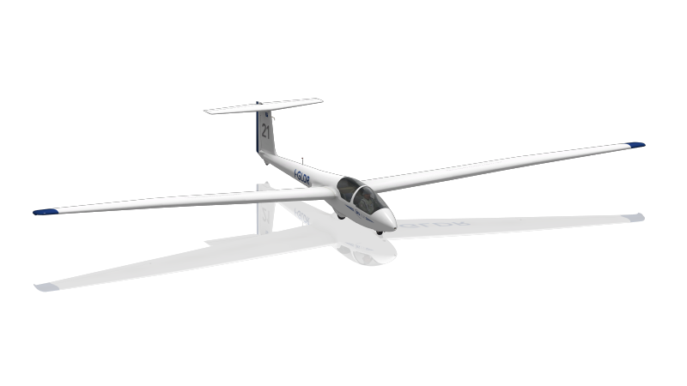
Laminar Schleicher ASK 21
Default Configuration – Laminar Research Schleicher ASK 21
HoneycombOnArm64MacOS
Rotary ALT | Rotary VS | Rotary HDG | Rotary CRS | Rotary IAS | Device | Active Toggle | Device | Button HDG | Button NAV | Button APR | Button REV | Button ALT | Button VS | Button IAS | Button AP
Barometer up/down | - | COM on/off | COM coarse up/down | COM fine up/down | - | None active | - | Canopy open/close | - | - | - | - | - | COM 1-2 flip | Tow release
 |  |  |  |  |  | Toggle 7
 |  |  |  |  |  | Toggle 6
 |  |  |  |  |  | Toggle 5
 |  |  |  |  |  | Toggle 4
 |  |  |  |  |  | Toggle 3
 |  |  |  |  |  | Toggle 2
 |  |  |  |  |  | Toggle 1
Back to contents
© Dr Steve Proctor 2024
swp336@gmail.com
Configuration Guide vBeta1.01

Slide 44
User guidance – Laminar Research Schleicher ASK 21
HoneycombOnArm64MacOS
COM Frequencies
If required, move the left-hand rotary to HDG and use the right-hand rotary to turn on the COM radio
Press the IAS button as required to select COM1 or COM2
Move the left-hand rotary to its bottom position (IAS) and use the right-hand rotary to adjust the frequency.
Use the left-hand rotary in the bottom two positions (IAS & CRS) to flip between adjusting the frequency right and
left of the decimal (equivalent to adjusting the inner and outer knobs on the COM control).
Back to contents
© Dr Steve Proctor 2024
swp336@gmail.com
Configuration Guide vBeta1.01

Slide 45

Laminar Sikorski S-76C
Default Configuration – Laminar Research Sikorski S-76C
HoneycombOnArm64MacOS
Rotary ALT | Rotary VS | Rotary HDG | Rotary CRS | Rotary IAS | Device | Active Toggle | Device | Button HDG | Button NAV | Button APR | Button REV | Button ALT | Button VS | Button IAS | Button AP
Altitude up/down | - | Pilot heading up/down | Pilot OBS up/down | - | Instrument panel | None active | AP panel | HDG | NAV | APP | - | ALT | Level change | Speed hold | AP
fast/slow |  | fast/slow | fast/slow | fast/slow |  | Toggle 7
 |  |  | COM / VLOC coarse up/down | COM / VLOC fine up/down | G530 | Toggle 6 | G530 | COM / VLOC toggle | VLOC active flip | COM 1 active flip
 |  | Map range up/down | FPL chapter up/down | FPL page up/down |  | Toggle 5 |  | CDI | FPL | PROC | Direct | MENU | CLR | CURSOR | ENT
 |  |  | COM2 coarse up/down | COM2 fine up/down | COM panel | Toggle 4 | COM panel | COM 2 active flip
 |  |  | NAV2 coarse up/down | NAV2 fine up/down | NAV panel | Toggle 3 | NAV panel | NAV 2 active flip
 |  |  | ADF 100s up/down | ADF 10s up/down | ADF panel | Toggle 2 | ADF panel | ADF flip active
Barometer up/down |  |  |  |  | Instrument panel | Toggle 1 | AP panel |  |  | ILS |  | Barometer STD
*
*
*
*
*
for rotary controls, the lowest numbered active toggle is the one applied
for autopilot buttons, the highest numbered active toggle is the one applied
* Aligned configuration – only one Toggle to be active at a time
Back to contents
© Dr Steve Proctor 2024
swp336@gmail.com
Configuration Guide vBeta1.01

Slide 46
User guidance – Laminar Research Sikorski S-76C
HoneycombOnArm64MacOS
MCP - Use Toggles 6 & 5 to configure the MCP NAV frequencies. Set Toggle 6* (check no other Toggles active) and move the left-hand rotary to its bottom position (IAS). Use the right-hand rotary to adjust the NAV1 frequency (use Toggle 5* for NAV2). Use the left-hand rotary in the bottom two positions (IAS & CRS) to flip between adjusting the frequency right and left of the decimal (equivalent to adjusting the inner and outer knobs on the NAV control).
Radio panel - Similarly, Toggles 4* & 3* (check no other toggles active) adjust the radio panel left and
right COM1 frequencies. (You can use Toggle 7 to control the speed it skips through the the decimal
values). Use the NAV button to flip the ‘active’ frequency switch between left and right.
ADF – Toggle 2* (check no other Toggles active) adjusts the ADF frequency. IAS & CRS flip between adjusting
the 10s units of the frequency and the 100s units. Once the correct frequency is dialed in, pressing the
HDG button will flip the active and standby values.
* Aligned configuration – only one Toggle to be active at a time
Back to contents
© Dr Steve Proctor 2024
swp336@gmail.com
Configuration Guide vBeta1.01

Slide 47
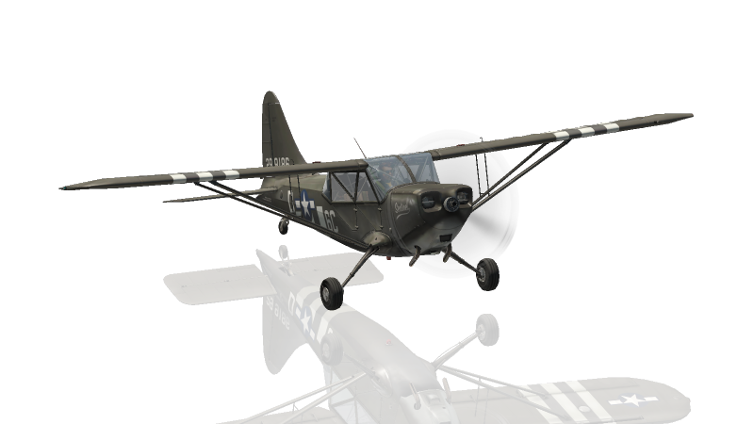
Laminar Stinson L5 Sentinel
Default Configuration – Laminar Stinson L5 Sentinel
HoneycombOnArm64MacOS
Rotary ALT | Rotary VS | Rotary HDG | Rotary CRS | Rotary IAS | Device | Active Toggle | Device | Button HDG | Button NAV | Button APR | Button REV | Button ALT | Button VS | Button IAS | Button AP
Barometer up/down | - | - | - | - | - | None active | - | - | - | - | - | - | - | COM 1 active flip | -
 |  |  |  | fast/slow |  | Toggle 7
 |  | COM1 on/off | COM coarse up/down | COM fine up/down |  | Toggle 6 |  |  |  |  |  |  |  | COM 1 active flip
Magneto selector up/down |  |  |  |  |  | Toggle 5
Fuel Selector up/down |  |  |  |  |  | Toggle 4
 |  |  |  |  |  | Toggle 3
 |  |  |  |  |  | Toggle 2
XPDR 1s up/down | XPDR 10s up/down | XPDR 100s up/down | XPDR 1000s up/down | XPDR mode selector | Transponder | Toggle 1
Back to contents
© Dr Steve Proctor 2024
swp336@gmail.com
Configuration Guide vBeta1.01

Slide 48
User guidance – Laminar Research Stinson L5 Sentinel
HoneycombOnArm64MacOS
COM - Use Toggle 6 to configure the COM frequency.
Set Toggle 6
If required, move the left-hand rotary to HDG and use the right-hand rotary to turn on the COM radio
Move the left-hand rotary to its bottom position (IAS) and use the right-hand rotary to adjust the frequency.
Use the left-hand rotary in the bottom two positions (IAS & CRS) to flip between adjusting the frequency right and left of the decimal (equivalent to adjusting the inner and outer knobs on the COM control). Remember, you can use Toggle 7 to control the speed it skips through
the decimal values
Once the correct frequency is set, press the IAS button to flip the COM active and standby values.
Transponder – Use Toggle 4 to adjust the transponder
Set Toggle 1
Move the left-hand rotary to its lowest position (IAS)
Use the right-hand rotary to adjust the transponder mode the STBY
Move the left-hand rotary up one click (CRS) and set the 1000s digit for the transponder code
Repeat one click up and one digit set until all 4 digits are correct
Move the left-hand rotary back to its lowest position (IAS) and set the transponder mode to ON or TST as required
Back to contents
© Dr Steve Proctor 2024
swp336@gmail.com
Configuration Guide vBeta1.01

Slide 49
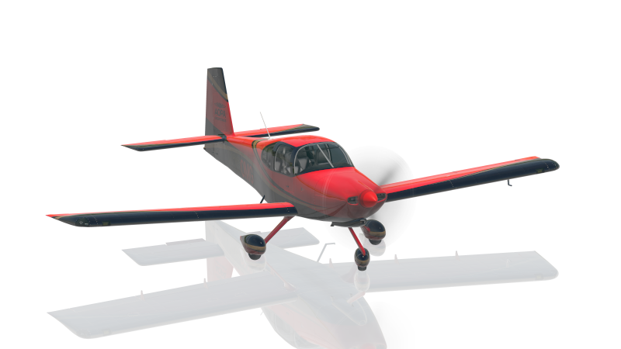
Laminar VAN’s RV-10
Default Configuration – Laminar Research VAN’S RV-10
HoneycombOnArm64MacOS
Rotary ALT | Rotary VS | Rotary HDG | Rotary CRS | Rotary IAS | Device | Active Toggle | Device | Button HDG | Button NAV | Button APR | Button REV | Button ALT | Button VS | Button IAS | Button AP
Altitude 1000s up/down | Nose up/down | Heading up/down | VOR1/VOR2 up/down | - | PFD | None active | AP panel | TRK | NAV | APR | REV | ALT | SEL | - | AP
fast/slow |  | fast/slow | fast/slow | fast/slow |  | Toggle 7
Barometer up/down |  |  | NAV coarse up/down | NAV fine up/down | PFD | Toggle 6 | PFD | NAV 1-2 toggle | NAV flip active
 |  |  | COM coarse up/down | COM fine up/down |  | Toggle 5 |  | COM 1-2 toggle | COM flip active
 |  | FLP range up/down | FPL chapter up/down | FPL page up/down | MFD | Toggle 4 | MFD |  | FPL | PROC | Direct | MENU | CLR | CURSOR | ENT
 |  |  |  |  |  | Toggle 3
 |  |  |  |  |  | Toggle 2 | PFD | VOR sync | AP VNAV
 |  |  |  |  |  | Toggle 1 | PFD | Heading sync | AP GPSS
*
*
for rotary controls, the lowest numbered active toggle is the one applied
for autopilot buttons, the highest numbered active toggle is the one applied
* Aligned configuration – only one Toggle to be active at a time
Back to contents
© Dr Steve Proctor 2024
swp336@gmail.com
Configuration Guide vBeta1.01

Slide 50
User guidance – Laminar Research VAN’S RV-10
HoneycombOnArm64MacOS
PFD - Use Toggles 6 to configure the PFD NAV frequencies. Set Toggle 6* (check no other Toggles active) and move the left-hand rotary to its bottom position (IAS). Press the HDG button to flip between NAV1 & NAV2 as required. Use the right-hand rotary to adjust the frequency. Use the left-hand rotary in the bottom two positions (IAS & CRS) to flip between adjusting the frequency right and left of the decimal (equivalent to adjusting the inner and outer knobs on the NAV control). Once the correct frequency is set, press the NAV button to flip the NAVx active and standby values.
Similarly, Toggle 5* (check no other toggles active) adjusts the PFD COM frequencies.
MFD flight plan entry. Set Toggle 4* (check no other Toggles active) and move the left-hand rotary to its
bottom position (IAS). The autopilot button map to the MFD buttons. Press FLP, PROC, Direct or MENU as
required. Use the IAS button to select the first field and then use right-hand rotary to move between fields.
Press AP to ‘enter’ a value. Use the left-hand rotary in the bottom two positions (IAS & CRS) to flip between
scrolling through a list and moving between lists (equivalent to adjusting the inner and outer knobs on
the FMS control).
If you move the left-hand rotary to its middle position (HDG) then the right-hand rotary zooms in and out
of the map.
* Aligned configuration – only one Toggle to be active at a time
Back to contents
© Dr Steve Proctor 2024
swp336@gmail.com
Configuration Guide vBeta1.01

Slide 51
HoneycombOnArm64MacOS
3rd Party Aircraft
Back to contents
© Dr Steve Proctor 2024
swp336@gmail.com
Configuration Guide vBeta1.01

Slide 52
Zibo 737-800
Default Configuration – Zibo Boeing 737-800
HoneycombOnArm64MacOS
Rotary ALT | Rotary VS | Rotary HDG | Rotary CRS | Rotary IAS | Active Toggle | Button HDG | Button NAV | Button APR | Button REV | Button ALT | Button VS | Button IAS | Button AP
Altitude up/down | Vertical speed up/down | Heading up/down | Pilot COURSE up/down | Airspeed up/down | None active | Heading select | LNAV | APP | - | ALT HOLD | VS | Speed | CMD A
fast/slow |  | fast/slow | fast/slow |  | Toggle 7
Captain Barometer up/down |  | MAP zoom in/out | Copilot COURSE up/down |  | Toggle 6
Captain decision height up/down |  | Bank angle up/down |  |  | Toggle 5
Captain HPA / IN flip |  | Captain Map mode |  |  | Toggle 4
 |  |  |  |  | Toggle 3 |  |  |  |  |  |  |  | CWS B
 |  |  |  |  | Toggle 2 | Captain EFIS TFC |  |  |  | Captain EFIS RST |  |  | CWS A
 |  |  |  |  | Toggle 1 | Captain EFIS CTR | VNAV | VOR/LOC |  | Captain EFIS STD | Level change |  | CMD B
for rotary controls, the lowest numbered active toggle is the one applied
for autopilot buttons, the highest numbered active toggle is the one applied
Back to contents
© Dr Steve Proctor 2024
swp336@gmail.com
Configuration Guide vBeta1.01

Slide 53
User guidance – Zibo Boeing 737-800
HoneycombOnArm64MacOS
The most common controls in flight operate by default (i.e., when no toggles are active).
Rotary workflows move with the toggles from right to left.
For example, for Altitude related functions set the left-hand rotary to the ALT position.
By default the right-hand rotary will adjust the altitude setting in the PFD (note that Toggle 7 can be used here to control moving quickly or accurately when adjusting the altitude).
Activating Toggle 6 will enable setting the captain PFD QNH,
Activating Toggle 5 will enable setting the captain decision height (no need to deactivate Toggle 6)
Activating Toggle 4 will enable setting the captain Baro units (no need to deactivate Toggle 5,
Now that the workflow is complete, unset all toggles.
The same approach applies to the other rotaries.
Button workflows move with the Toggles from left to right.
For example, for Heading related functions
By default the HDG button on the Bravo triggers the HDG button AP panel
Activating Toggle 1 maps the HDG button on the Bravo to the Captain’s EFIS CTR button
Activating Toggle 2 maps the HDG button on the Bravo to the Captain’s EFIS TFC button
Note, for this aircraft the Buttons only use Toggle 1-3 and the Rotarys only use Toggles 4-7, so both Button settings and Rotary settings can be active
simultaneously as they do not overlap and will not interfere with each other. For example, Toggles 1 and 6 can both be active and you will get the
expected behaviour from the Buttons and Rotarys.
Back to contents
© Dr Steve Proctor 2024
swp336@gmail.com
Configuration Guide vBeta1.01

Slide 54
HoneycombOnArm64MacOS
End of Configuration Guide
Back to contents
© Dr Steve Proctor 2024
swp336@gmail.com
Configuration Guide vBeta1.01

